Slide 1
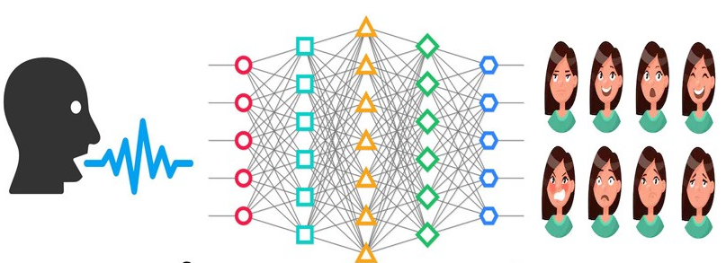
End to End Speech Emotion Recognition with Gender Information -by TING wei sun
RDBMS IA 1
BY-BHAIRAV NARKHEDE
1911003

Slide 2
Introduction
This paper focuses on the analyzing speech emotions by apply deep learning algorithm
This paper also focuses on gender recognition for increasing performance.
Human emotions can be classified into six different forms: excited, neutral, frustrated, anger, happiness and sadness
The dataset to be used is IEMOCAP data(English).

Slide 3
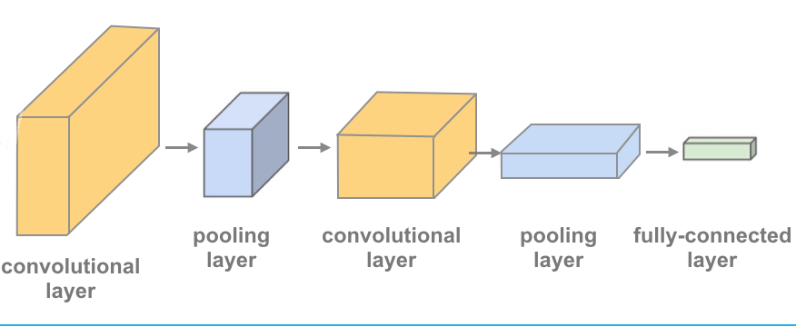
Convolutional Neural Networks (CNNs)
Convolutional neural networks are composed of multiple layers of artificial neurons.
Neuron is basically a function that takes multiple inputs and gives out output.

Slide 4
The CNN simultaneously obtains necessary information from the speech data and classifies the emotion category.
This paper has indicated the impact of gender information on the performance of speech emotion recognition.(accuracy growth by 2%-4%)
Model uses only the raw speech signal and combines gender information to accomplish speech emotion recognition

Slide 5
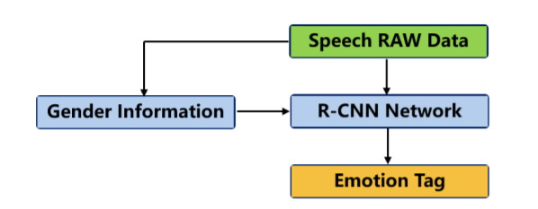
Basic architecture

Slide 6

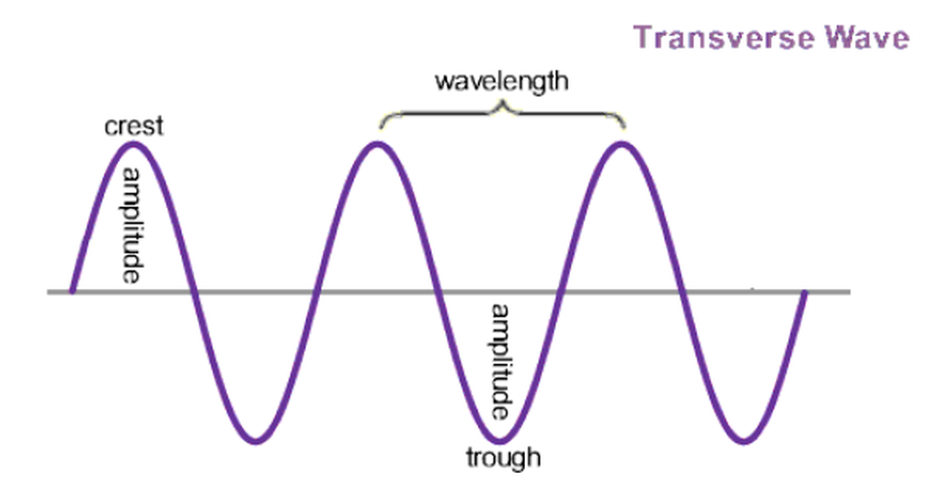
Feature extraction
Humans express emotion through communication, and a speech signal is the main container with all the necessary information to express emotion.
The sound wave can express the stress and intonation of the speaker. Loudness, intensity, duration, and pitch are most representative of speech features.
The result is number array representation of emotional speech

Slide 7
Gender information in speech recognition
The shape of vocal tracts is quite different between human genders. The variance in emotional features may be very different in the same emotion category and very small between different emotion categories.
By including gender information, this system will be reliable, and the neural network will have one more feature to make emotional vocal features of the two genders as a basic grouping.
Hence the author include this feature in the emotion analysis.

Slide 8
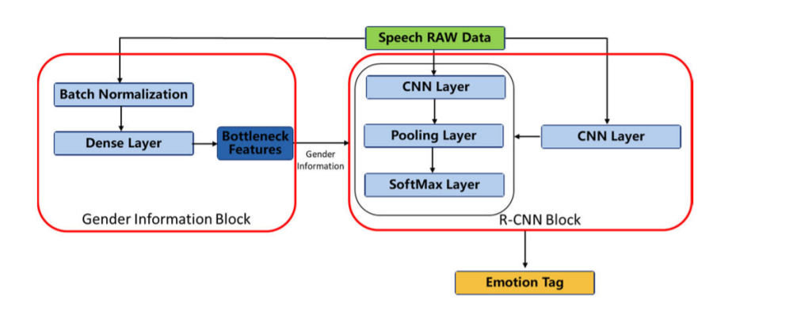
Model
The proposed algorithm combines an emotion recognition block and a gender information block.
The raw speech data is sent to these two blocks simultaneously.
The R-CNN network obtains the necessary emotional information from the speech data and classifies the emotional category.

Slide 9
Training
We train gender information and emotion individually. First, we train the gender information network with binary output
The output is given as an input feature to emotion recognition for increasing the performance.

Slide 10
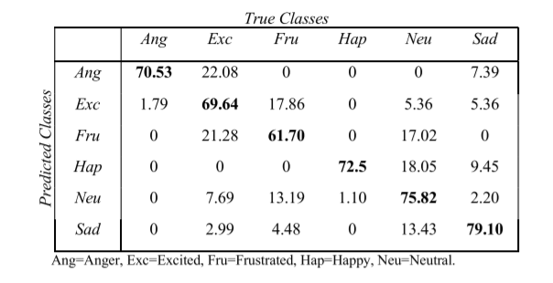
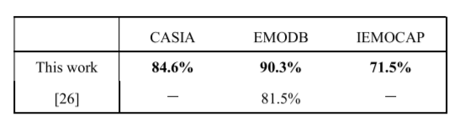
Confusion Matrix (%) of the proposed algorithm in English database IEMOCAP.

Slide 11
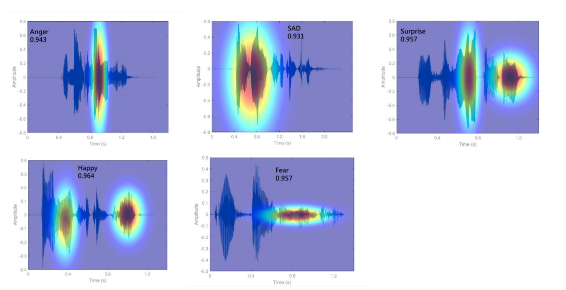

Slide 12
application
This can be used for advertisement selection.
Home automation can also use speech emotion recognition and then act according to it.
This can also be used to train pilot in aviation industry

Slide 13
Implementation details
Using librosa library provided by python for feature extraction of audio file
Librosa also has display function to show spectrogram
Dataset to be selected is available on Kaggle

Slide 14
Conclusion
Add gender information to improve recognition accuracy
The algorithm only works with discrete speech signals

Slide 15
References
https://ieeexplore.ieee.org/document/9170617
https://en.wikipedia.org/wiki/Convolutional_neural_network

Slide 16
Thank You

